Slide 1


The Power of Data: Capturing the Indian Market
Marketing Insights for CodeX Success
- By Akash Pandey

Slide 2
AGENDA
About Us
The Objective
Insights
01
02
03
Recommendations & Strategy
04

Slide 3

01
ABOUT US

Slide 4
CodeX
CodeX: Your Source of Limitless Energy!
CodeX is a German beverage company that is aiming to make its mark in the Indian market. A few months ago, we launched our energy drink in 10 cities of India.

Slide 5
THE OBJECTIVE
02
Convert survey results into actionable insights and analyze the survey responses from 10,000 respondents in 10 cities to uncover valuable consumer preferences, identify potential product enhancements, determine optimal pricing strategies, and devise targeted marketing campaigns.

Slide 6

INSIGHTS
03
Let’s Go!

Slide 7
INSIGHTS
Demographic
Consumer Preferences
Market Analysis
Purchase Behaviour
Our Product

Slide 8
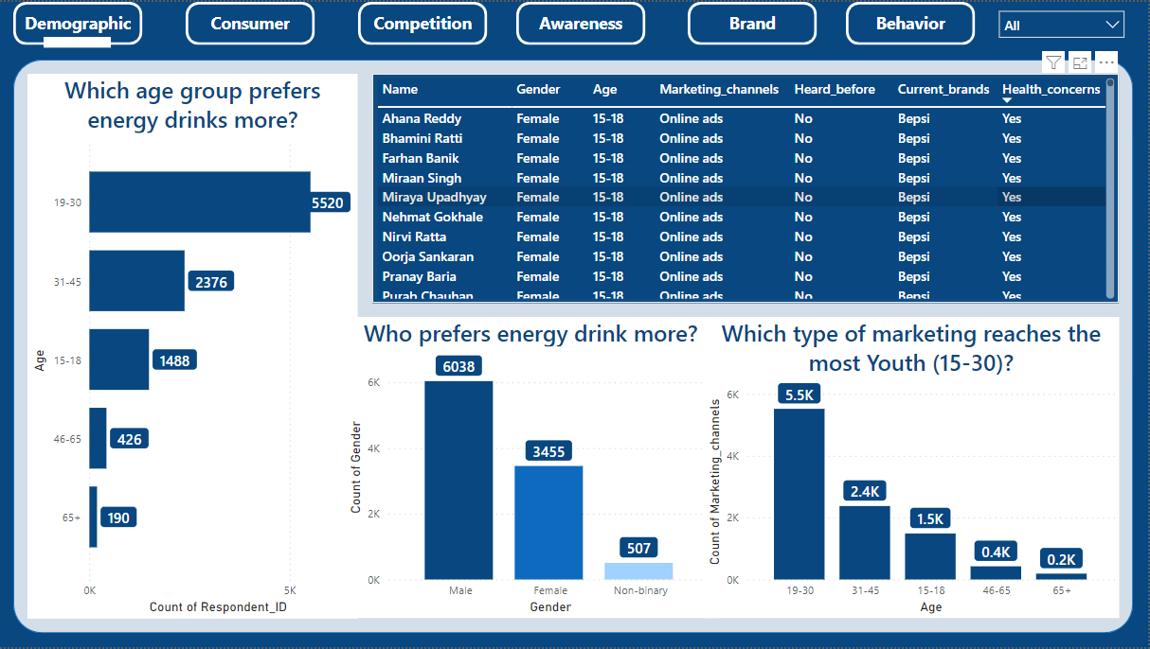

Slide 9
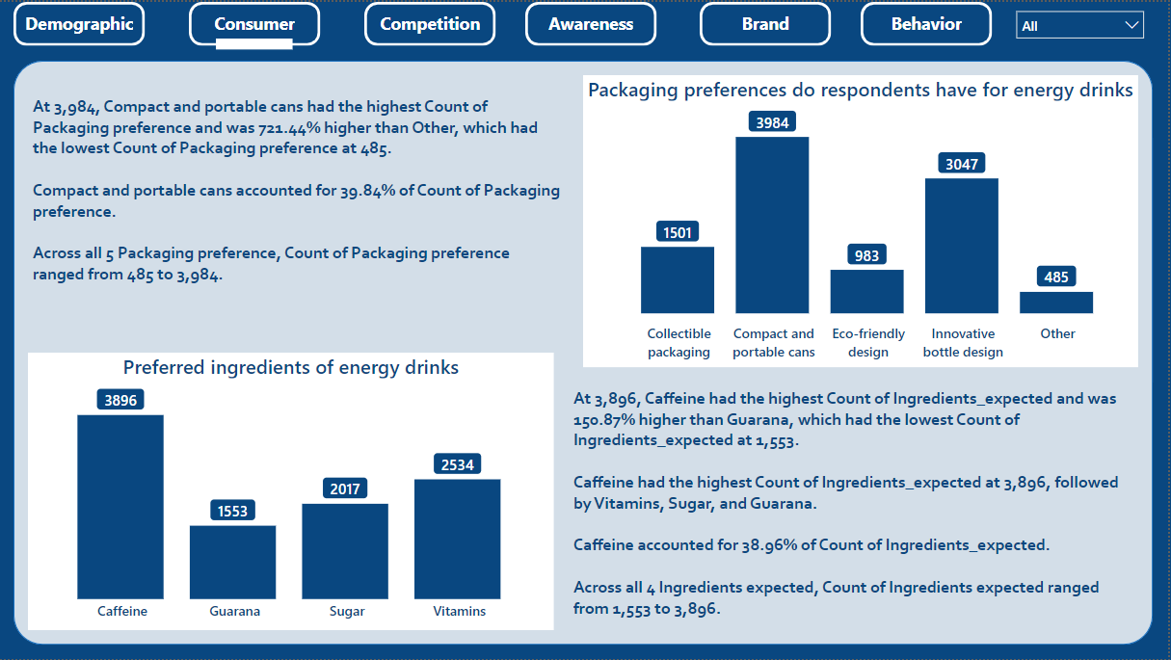

Slide 10
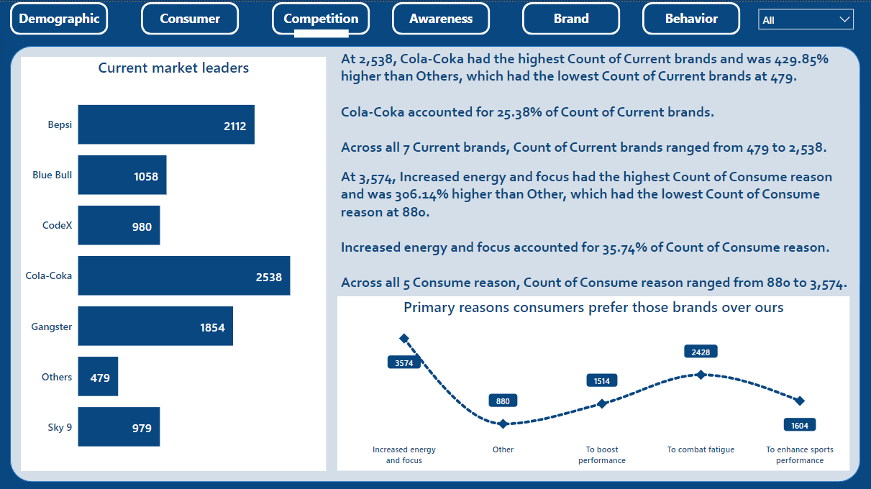

Slide 11
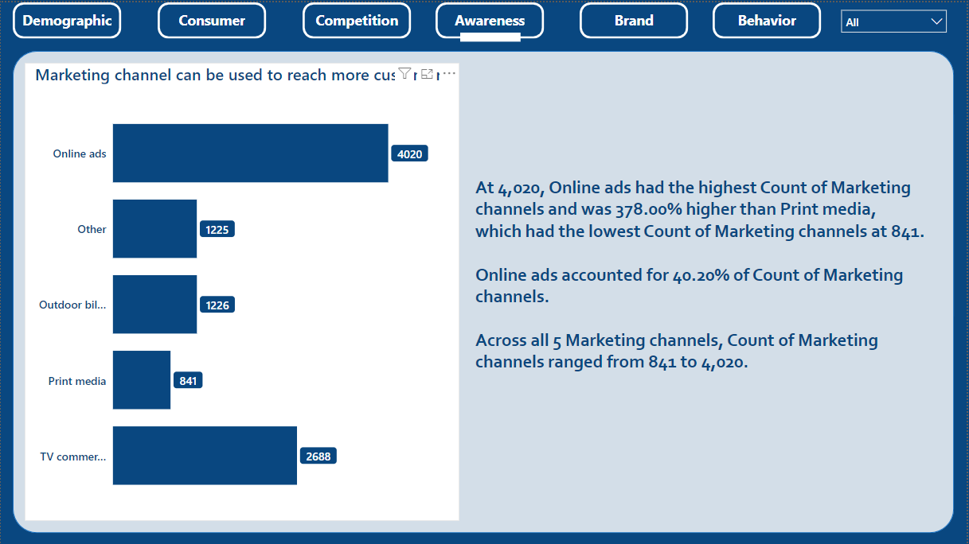

Slide 12
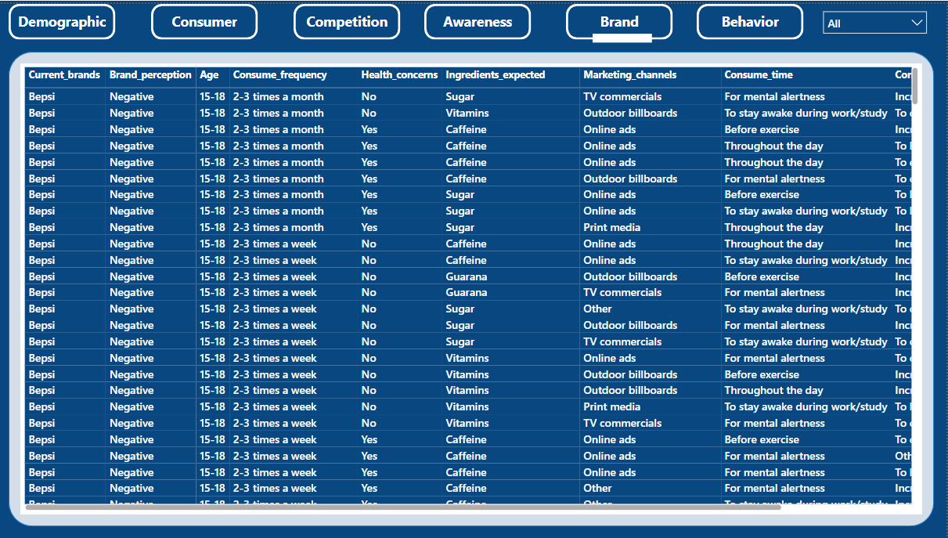

Slide 13
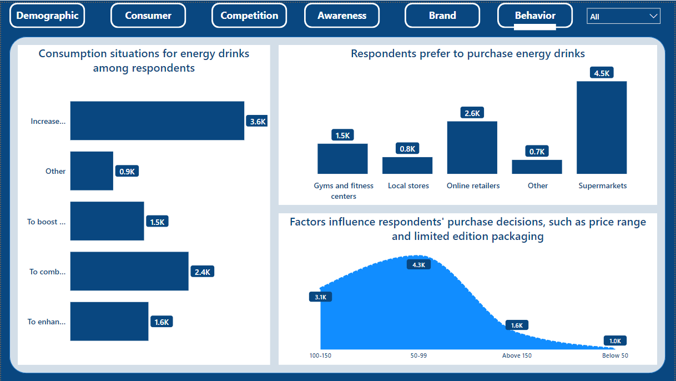

Slide 14
RECOMMENDATIONS & STRATEGY
!!!
04

Slide 15
What immediate improvements can we bring to the product?

Slide 16

Caffeine is the most preferred ingredient.

Slide 17
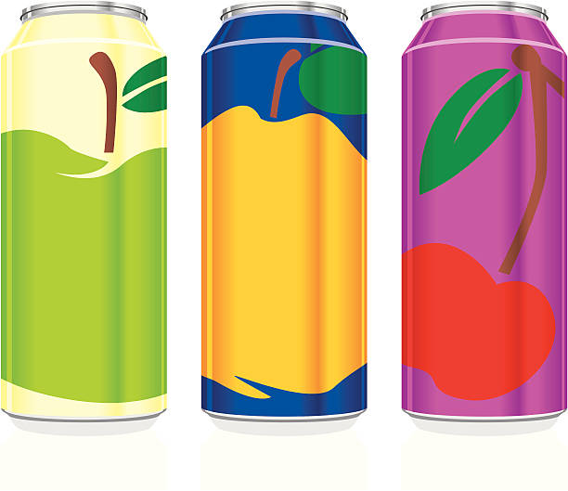
Compact and portable cans are the preferred packaging.

Slide 18
What should be the ideal price of our product?

Slide 19

Price range should be around 50-99

Slide 20
Who can be our brand ambassador, and why?

Slide 21

Virat Kohli

Slide 22
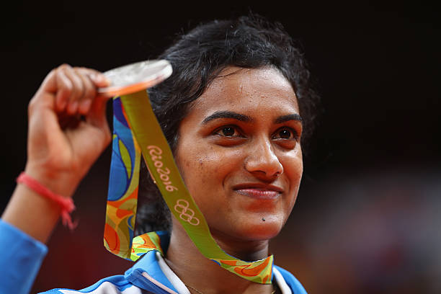
P V Sindhu

Slide 23
What kind of marketing campaigns, offers, and discounts we can run?

Slide 24

Online ads are highly effective!

Slide 25

Leverage social media platforms and influencers to amplify brand visibility and engagement.

Slide 26

Partner with gyms and fitness centers to offer special promotions or product placement opportunities.

Slide 27



Sponsor local sporting events to increase brand visibility and engagement.
CodeX

Slide 28
Who should be our target audience, and why?

Slide 29
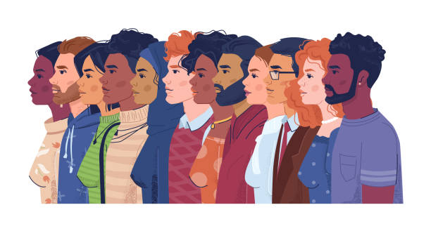
GENDER
AGE GROUP
55.2%
19-30
60.38%
Male
Tier 2
Tier 1
CITIES TO FOCUS ON

Slide 30
STRATEGY
Improve Brand Perception
Target the Right Audience
Focus on Product Development
Create a more eye-catching and memorable brand name/logo/design
Improve overall brand experience, including taste, flavour, and packaging.
The target audience for energy drinks is males in the 19-30 age group.
There is a growing demand for energy drinks among women and older consumers
Improve taste by using more natural ingredients and reducing the sugar content.
CodeX is not available in all parts of the country. This can be improved by expanding distribution to more stores and online retailers.

Slide 31

TRACK THE EXPENSES!

Slide 32

THANKS!
TOO GOOD!
DO YOU HAVE ANY QUESTIONS?
mailboxakash2@gmail.com

